Slide 1
Operating System Principle Chapter 1: Introduction
Feb, 2024

Slide 2
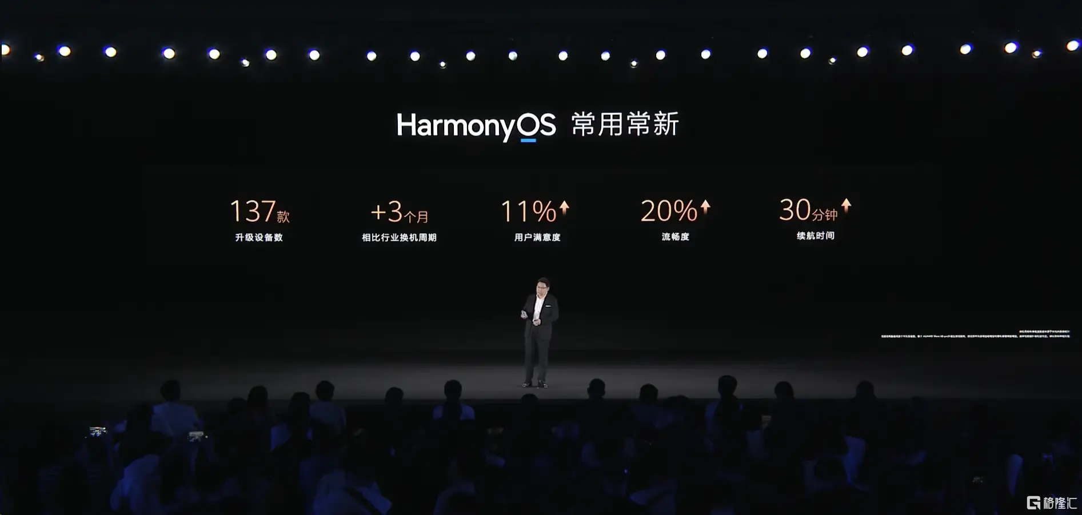
Harmony OS
2024-2-22

Slide 3
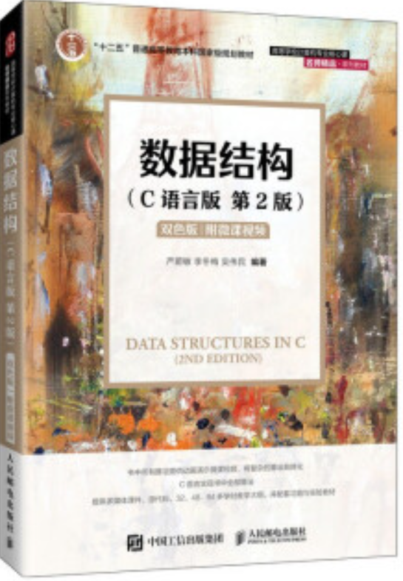
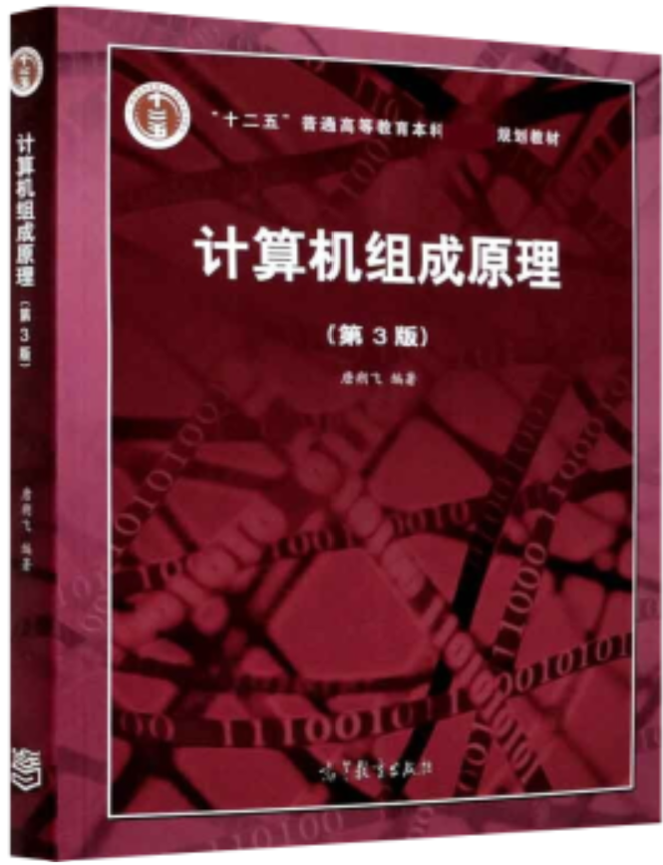
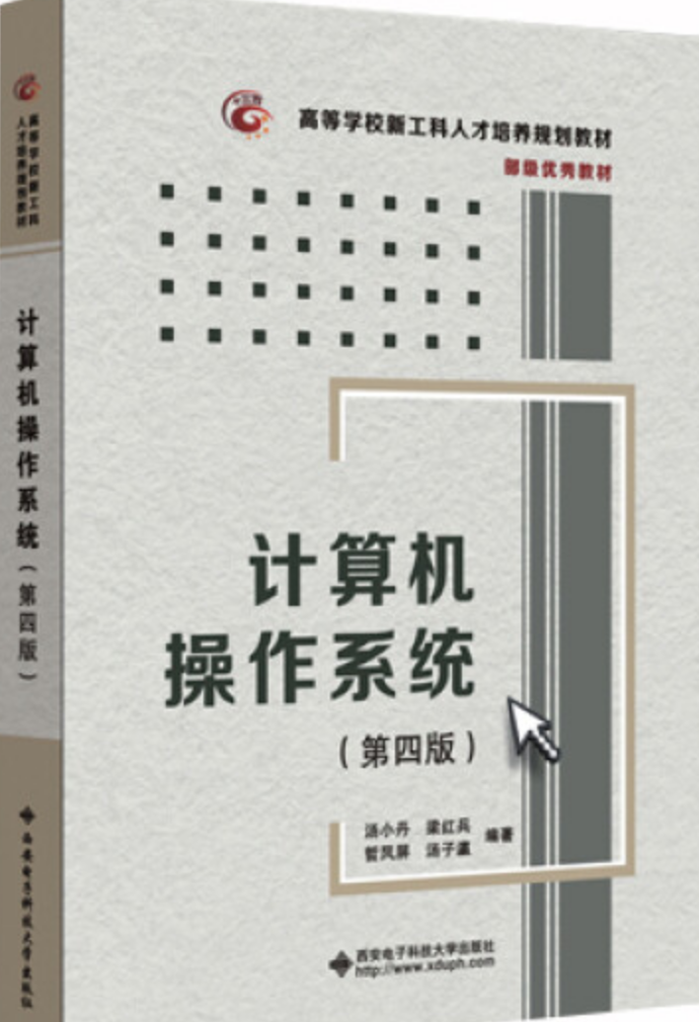
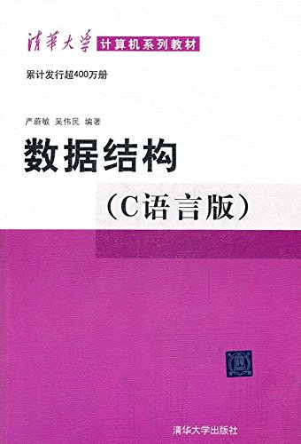
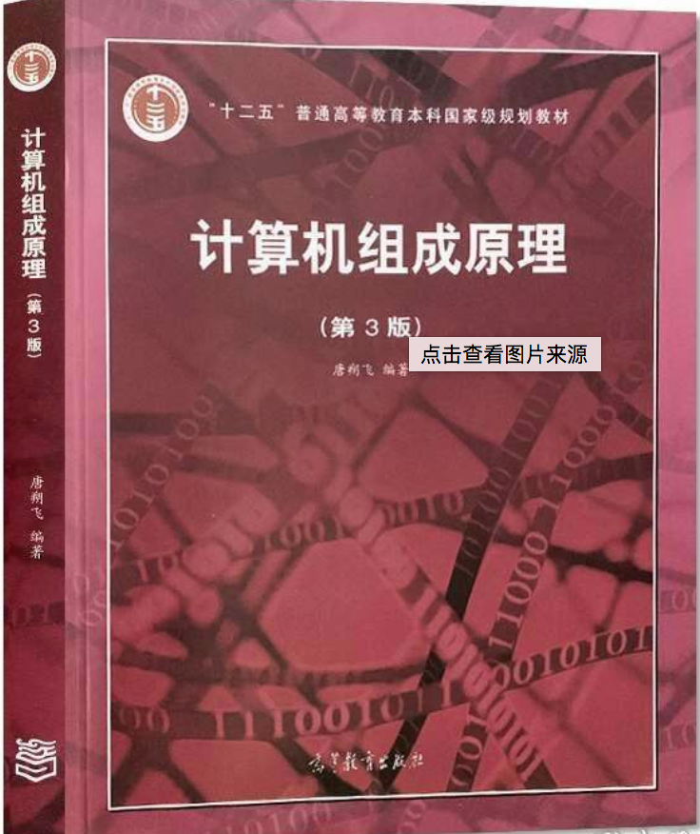
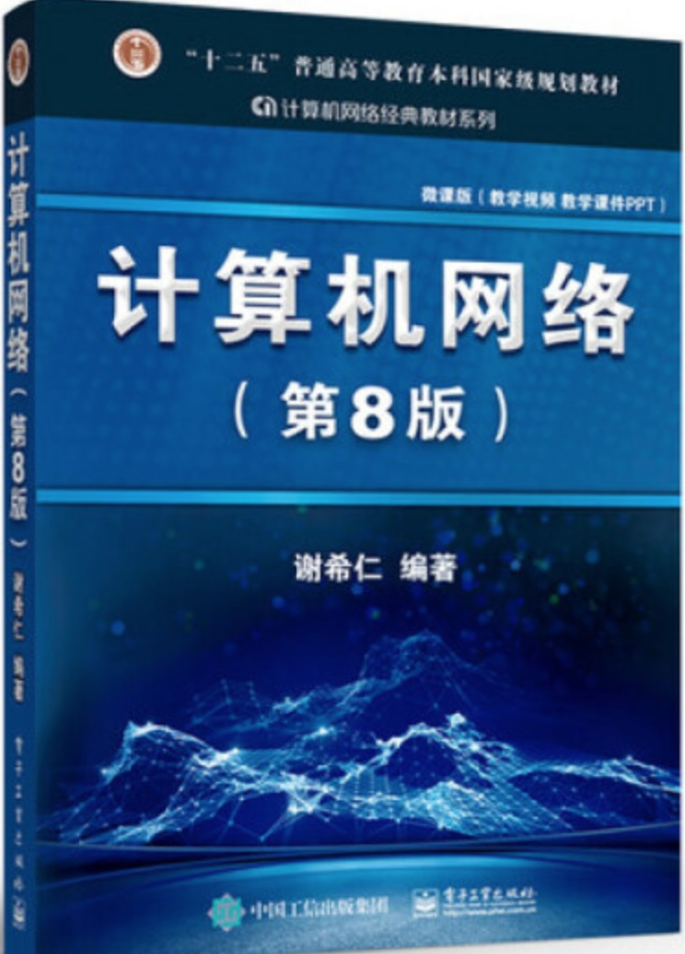
Welcome to OS

Slide 4
Prerequisites
Programming Language: C， Assembly
Data Structure
Organization of Computer System

Slide 5
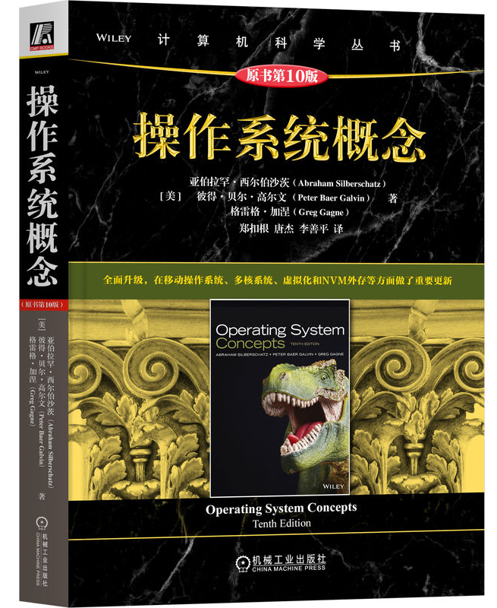
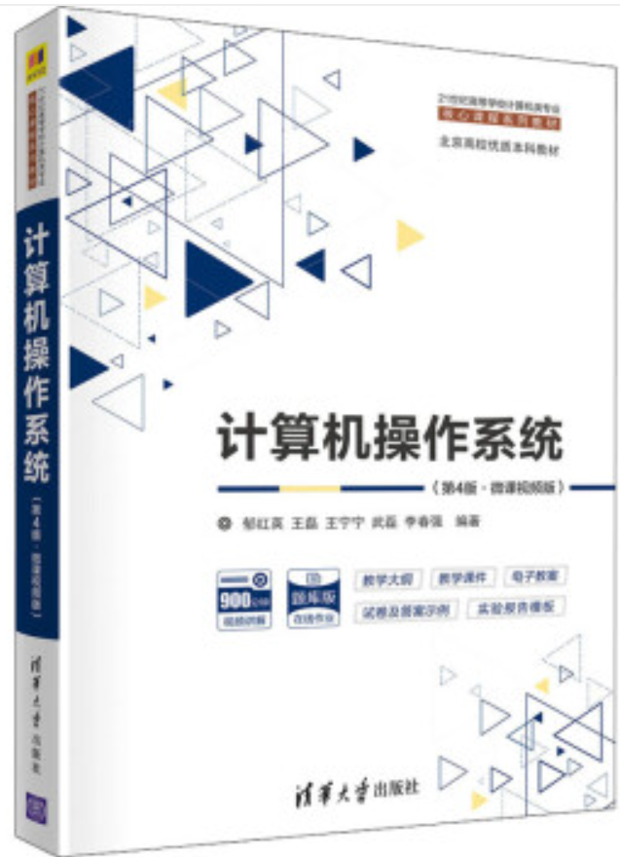
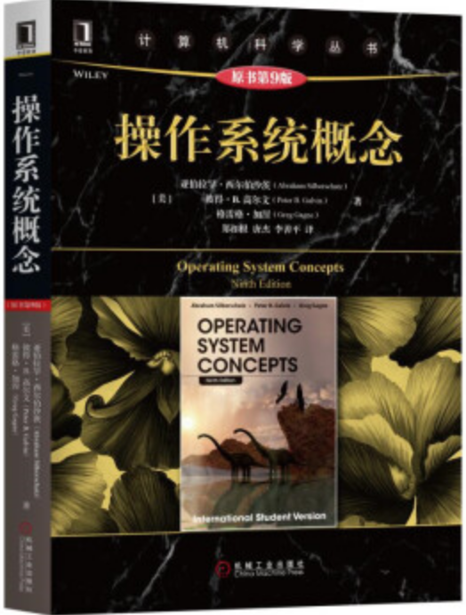
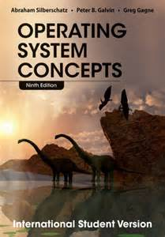
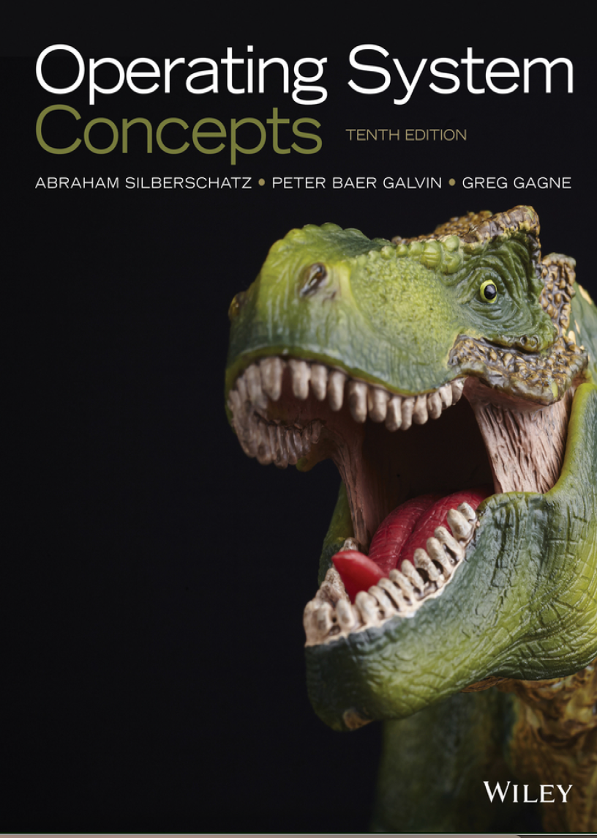
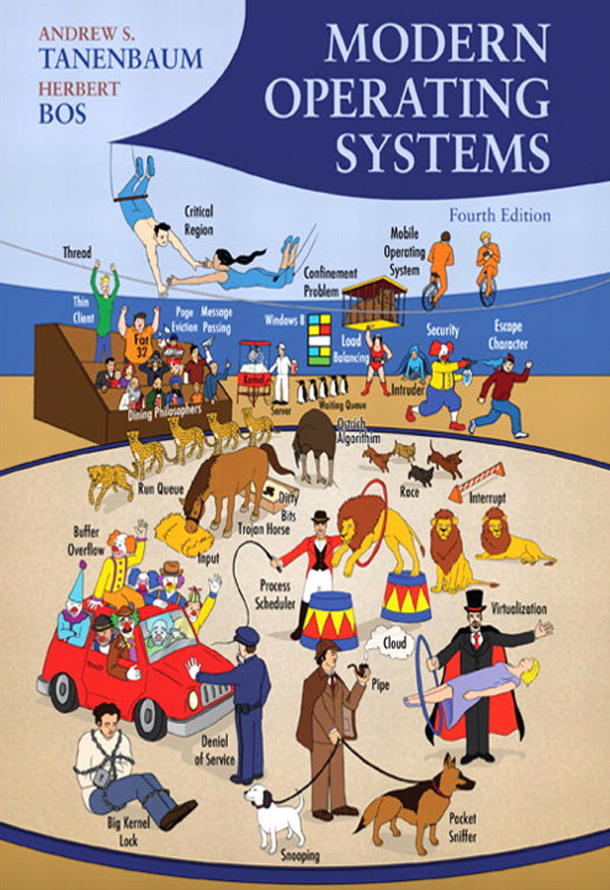
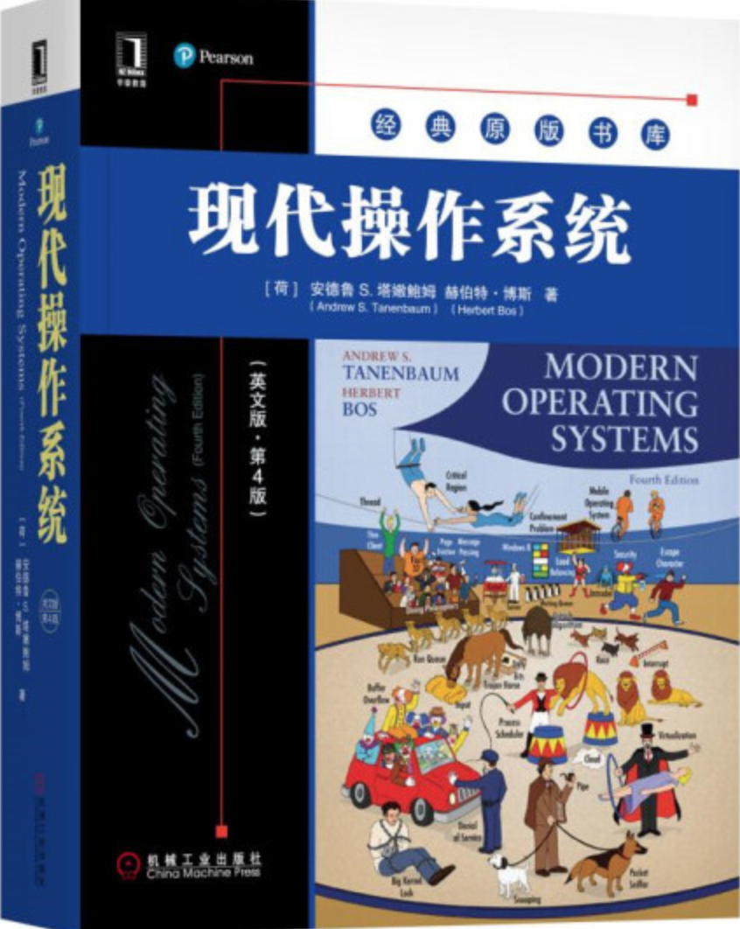
Textbooks
Operating System Concepts, 9th Edition. Abraham Silberschatz, Peter Baer Galvin, Greg Gagne, John Willey & Sons Inc. 2014
References
Modern Operating Systems, 4th Edition. Andrew S. Tanenbaum and Herbert Boss, Person Education, Inc., 2015
《计算机操作系统》(第4版)，郁红英 王磊等编著，清华大学出版社，2022

Slide 6
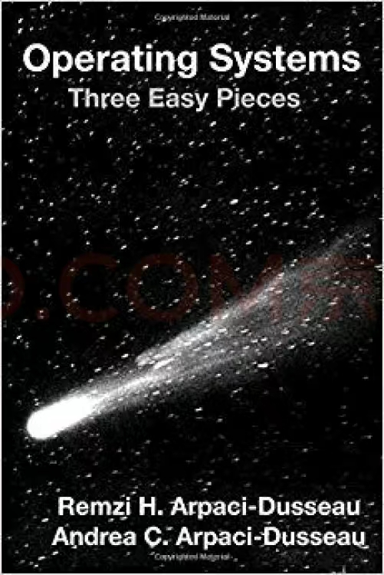
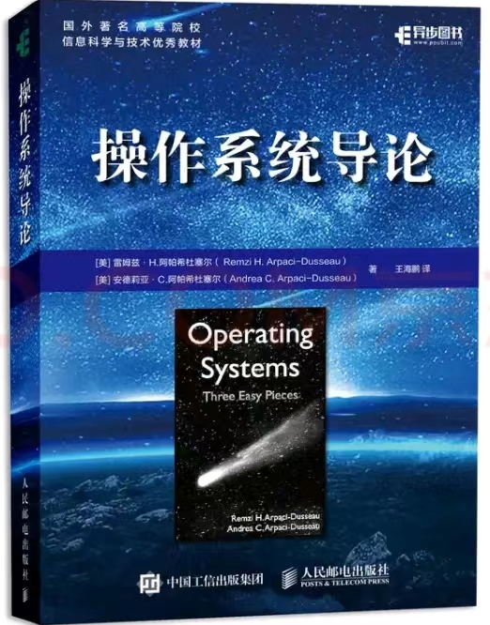
Textbooks
Remzi H. Arpaci-Dusseau and Andrea C. Arpaci-Dusseau. Operating Systems: Three Easy Pieces, Arpaci-Dusseau Books, November, 2023 (Version 1.10)
操作系统导论，王海鹏译，人民邮电出版社，2019

Slide 7
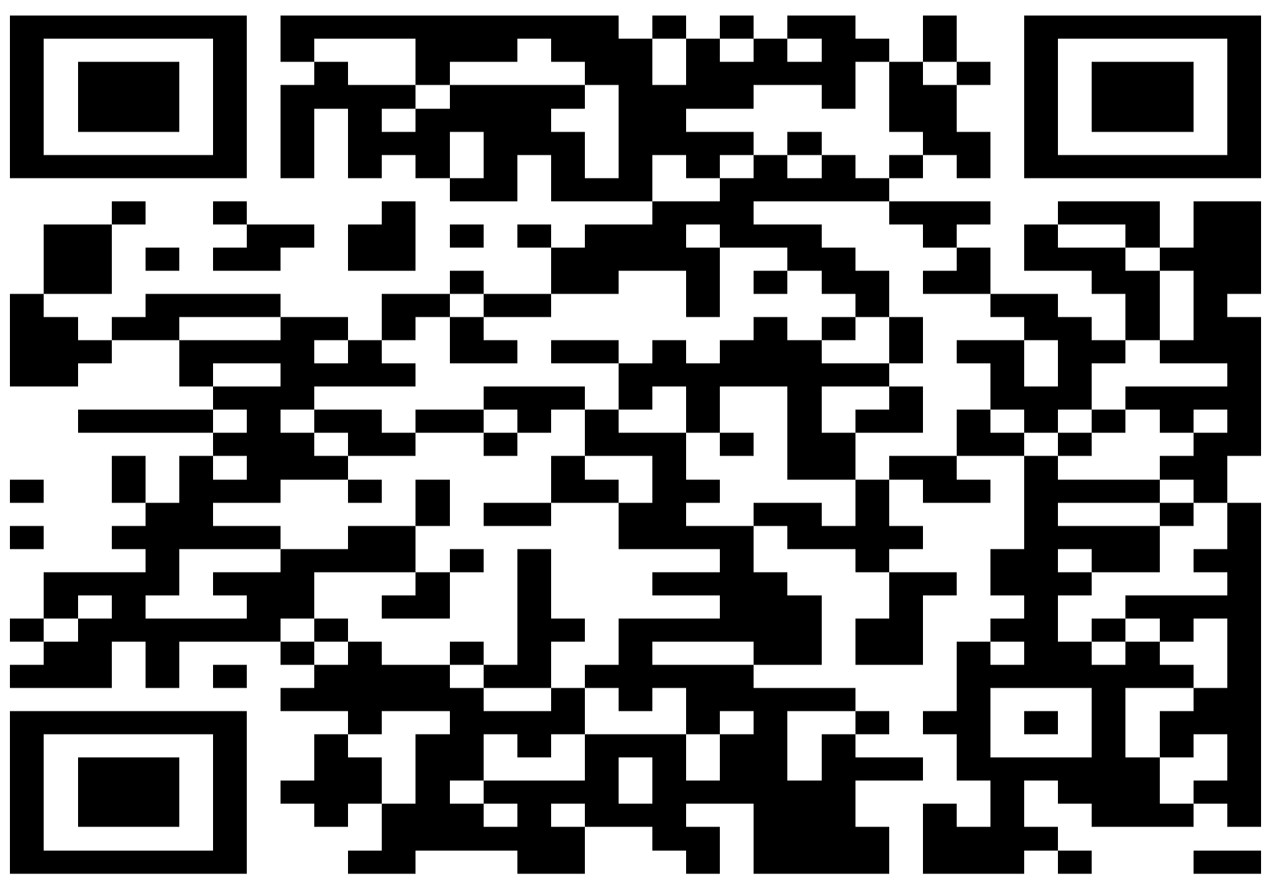
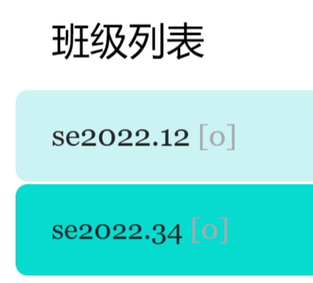
Homework and Lab Reports
https://www.scholat.com/course/os2024swu
班级：
申请加入时请提供完整学号和姓名！

Slide 8
Evaluation
Final exam: 60%
Labs: 20%
Homework: 20%
Attendance
Class performance

Slide 9
Contact
赵恒军
18302301799
zhaohj2016@swu.edu.cn

Slide 10
Chapter 1: Introduction
What is operating system
The organization of computer system
The main functionality of operating system
The development history of operating system

Slide 11
Objectives
To introduce the definition and functionality of operating systems
To describe the basic organization of computer systems
interrupt
To provide a grand tour of the major components of operating systems

